Slide 1
User-as-Graph: User Modeling with Heterogeneous Graph Pooling for News Recommendation
IJCAI 2021
2021.09.19 • ChongQing
Reported by Chenghong Li

Slide 2
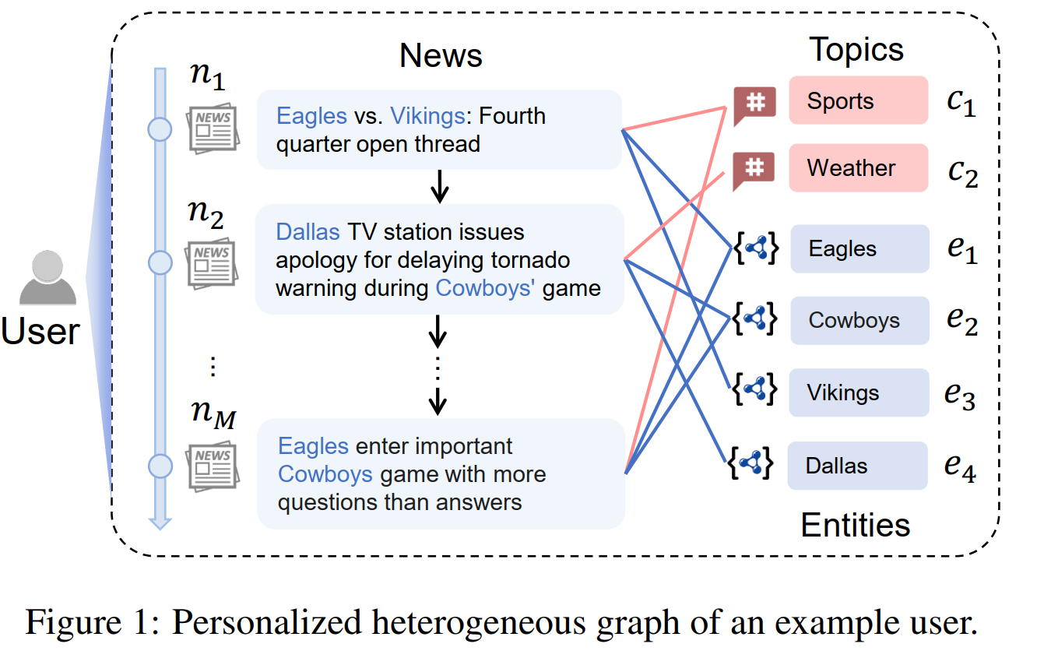
Introduction

Slide 3
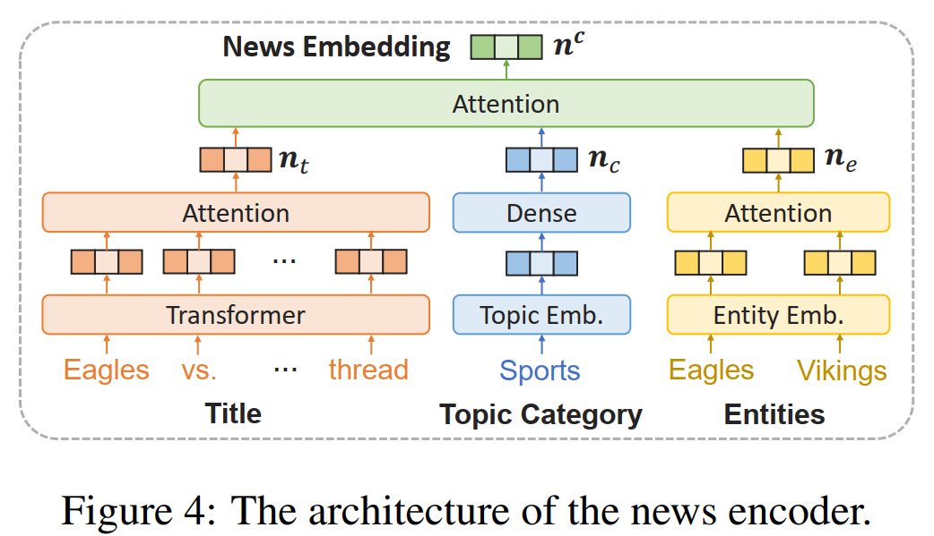
Method

Slide 4
Method

Slide 5
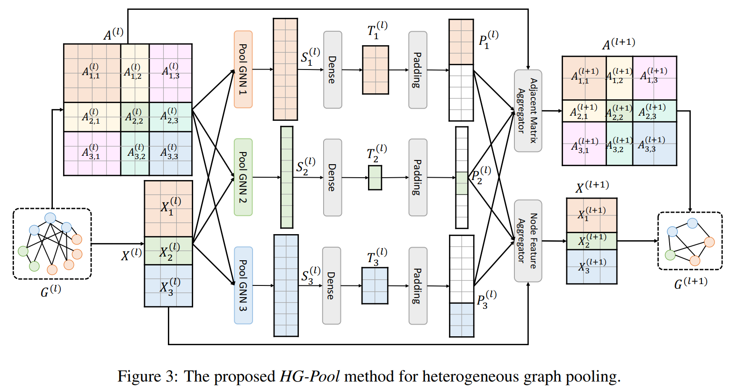
Method

Slide 6
Experiments

Slide 7
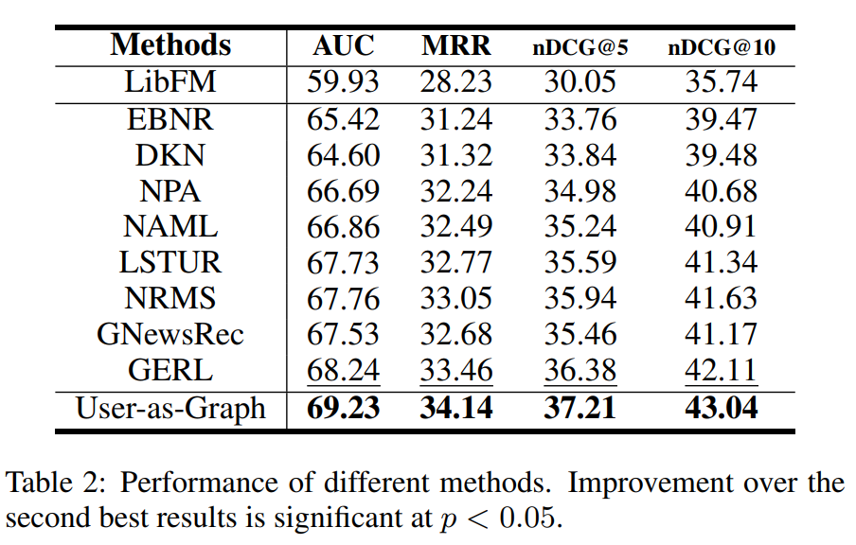
Experiments

Slide 8
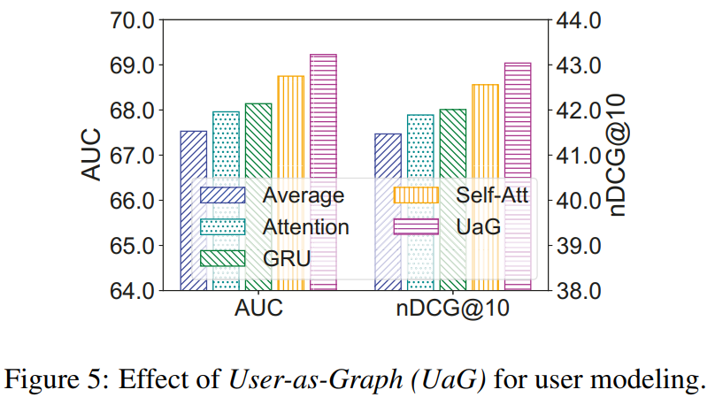
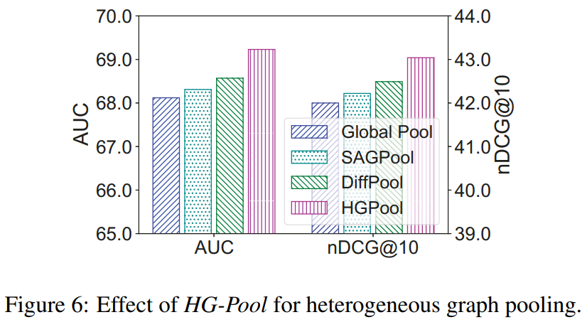
Experiments

Slide 9
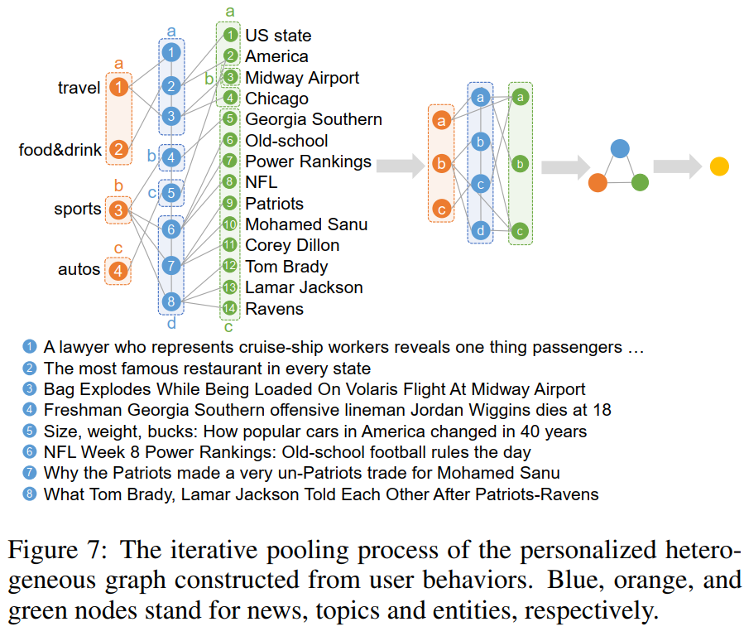
Experiments

Slide 10
Thanks

